Slide 1
Statistics and Reliability: Module 10
Design of Experiments (DOE)
Notes:
Module Topics
Basic terms: Define and describe basic DOE terms such as independent and dependent variables, factors and levels, response, treatment, error, repetition, and replication.
Main effects: Interpret main effects and interaction plots.
Copyright (c) Deere & Company, as an unpublished work. This material is the property of Deere & Company. All use, disclosure, and/or reproduction not specifically authorized by Deere & Company is prohibited.

Slide 2
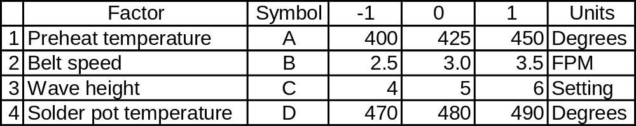
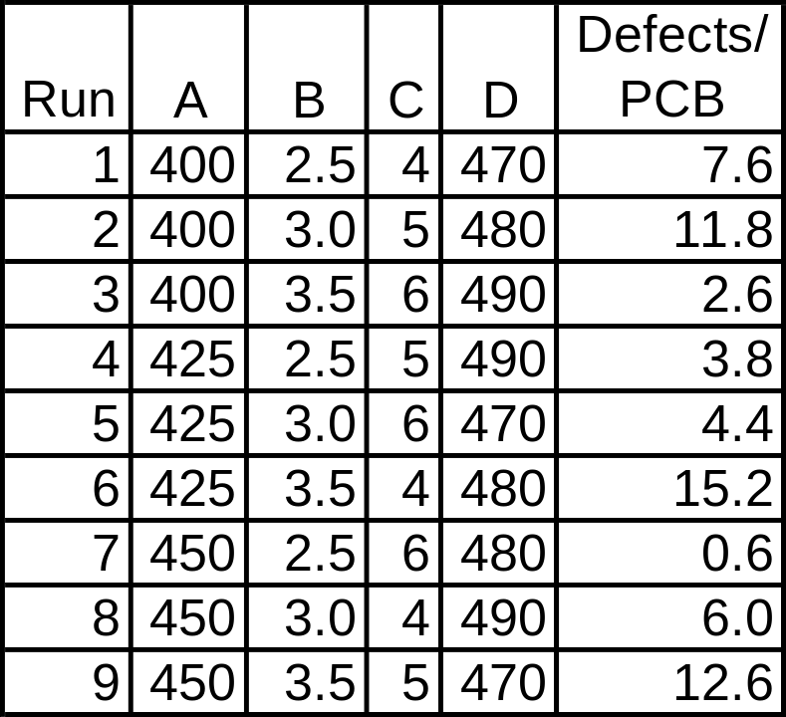
Design and analysis of DOE for mixed technology PCBs
Notes:
Table 8.1 from Six Sigma for Electronics Design and Manufacturing, page 247.
“This case study involves PCBs that are double-sided with mixed technology of through-hole and SMT components. The PCBs were wave soldered, resulting in poor quality... It was decided to perform a DOE on the solder operation for this particular PCB to see if it required a different operational setup of the solder wave machine than the rest of the PCB population.”

Slide 3
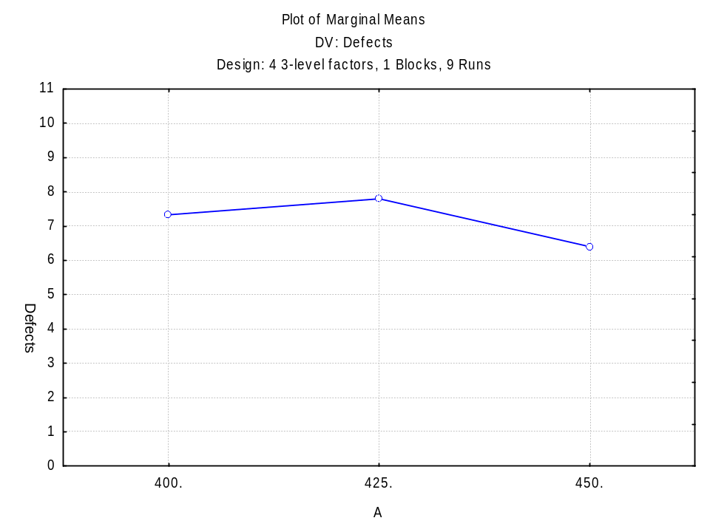
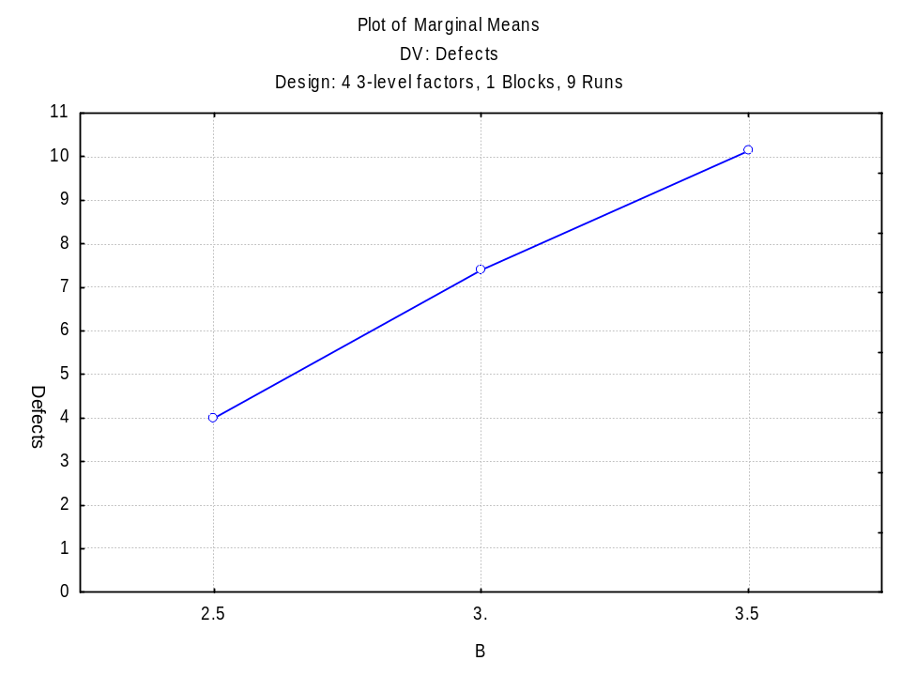
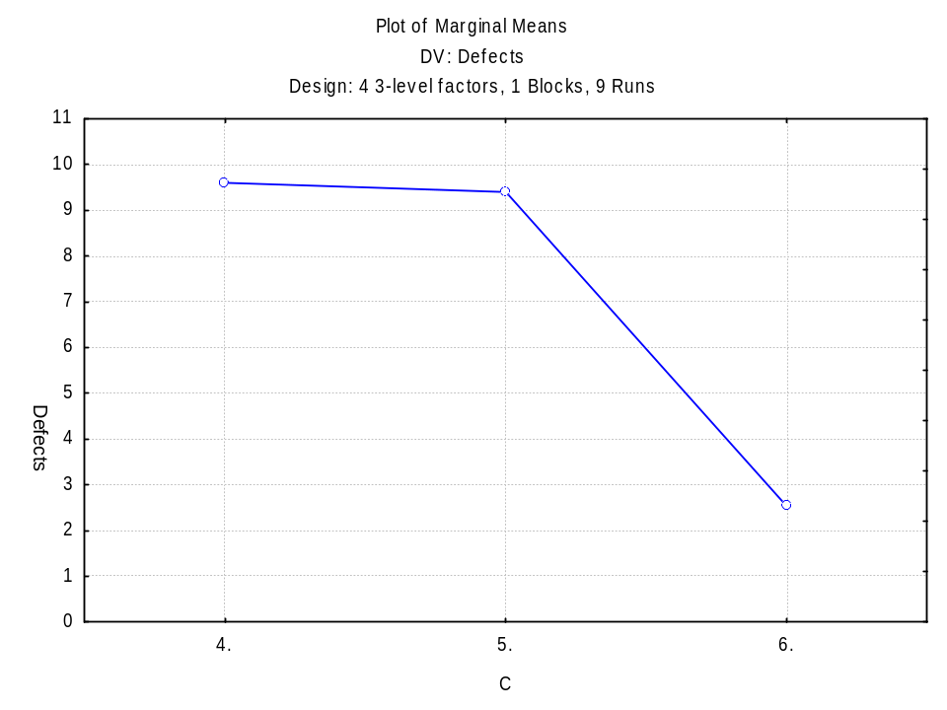
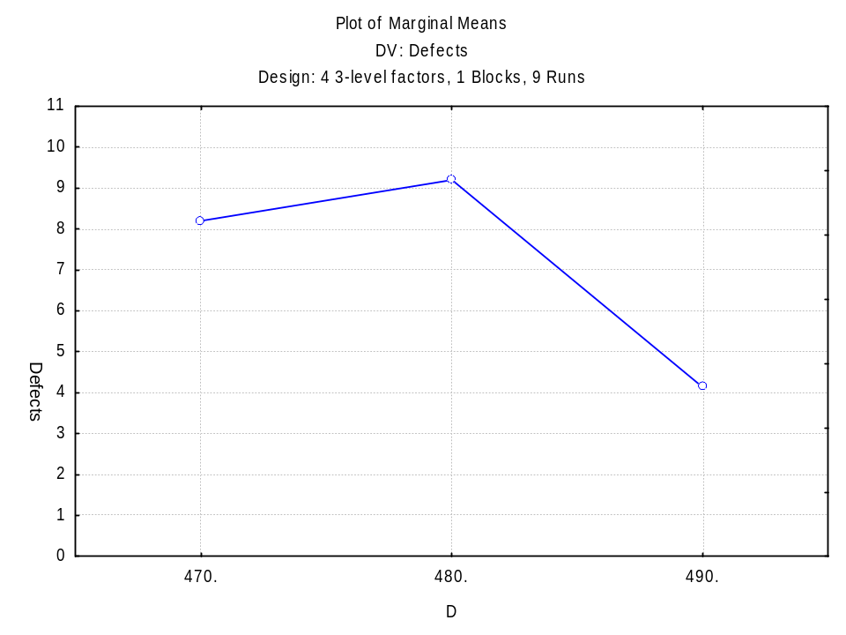
Notes:
Conclusions:
A: Preheat temperature is not significant over this range – set at most productive temperature (400 degrees?).
B: Set belt speed at 2.5 FPM.
C: Set Wave height at setting 6.
D: Set solder pot temperature at 490 degrees.

Slide 4


Which came first, the chicken or the egg?
Which comes first, the DOE design or DOE analysis?
Knowledge of design leads to good analysis
DOE Design
DOE Analysis
Statistica
Statistica
Knowledge of analysis leads to good designs
Notes:
DOE Design: Design space, factors and levels, experimental design layout, number of trials/runs, confounding, aliasing, center points, replicates, randomization, blocking, etc. (more art than science?)
DOE Analysis: Data, statistical significance, curvature, empirical model, etc. (more science than art?).
In order to design a good experiment, you need to know how the data can and should be analyzed; in order to properly analyze an experiment, you should know how it was designed and conducted. Which comes first? Just like the chicken and the egg, no one knows, but we do know you need both. That is, you can’t have one without the other!
In reality, the design should come first. But in order to design an experiment well, you should know how to analyze it. So in that respect, the analysis comes first, at least as a “thought experiment.” Or better yet, randomly generate data for a proposed design and analyze that before you actually conduct the design to see what you can and cannot determine.

Slide 5
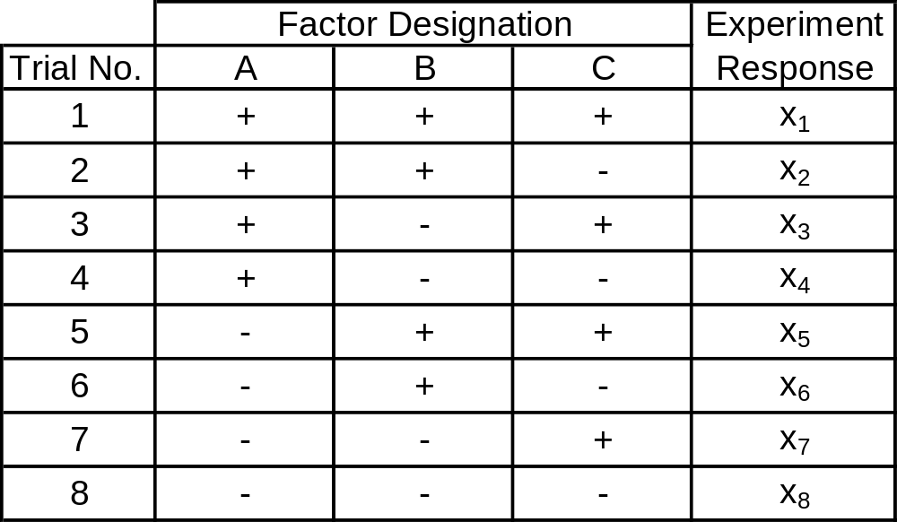
Table 28.1 Two-Level Full Factorial Experiment Design
Notes:
Page 557: “When executing a full factorial experiment, a response is achieved for all combinations of factor levels. The three-factor experiment design in Table 28.1 is a two-level full factorial experiment. For analyzing three factors, eight trails are needed (i.e. 2³ = 8) to address all assigned combinations of the factor levels. The plus/minus notation illustrates the high/low level for the factors. When a trial is performed, the factors are set to the noted plus/minus limits (levels) and a response value is then noted for the trail.”

Slide 6
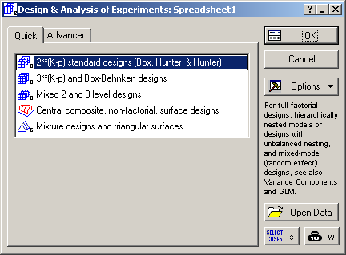
Notes:
Statistics > Industrial Statistics & Six Sigma > Experimental Design (DOE) > 2**(K-p) standard designs

Slide 7
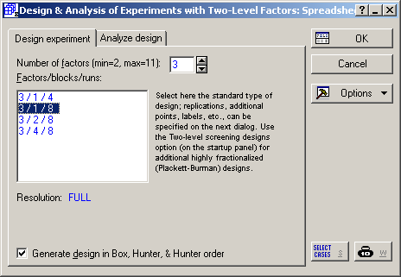
Notes:
Number of factors = 3
Factors/blocks/runs = 3/1/8
Note: Resolution = FULL
Select “OK”.

Slide 8
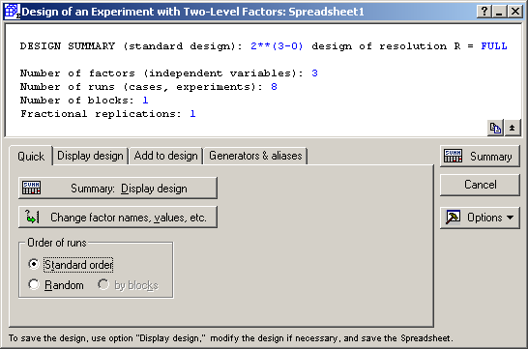
Notes:
Summary data is listed in the top section.
Change the “Order of runs” to “Standard order”. [Use “Random” order when you have finalized the design and are ready to run the experiments.]
The select “Summary: Display design”.

Slide 9
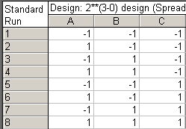
Notes:
Compare to Table 28.1 Two-Level Full Factorial Experiment Design.
The same combinations are listed, but the order of the rows is different. One could sort the rows to get them to match, but that would be superfluous. You could also uncheck “Generate design in standard Box, Hunter & Hunter order” on the menu where you specified the number of factors and runs, but that still doesn’t match Table 28.1 (and who cares anyway).
If this was an adequate design, then we would return to the DOE menu, label the factors A, B and C and the levels -1 and 1, display the matrix in random order, and add a column to record the response.

Slide 10
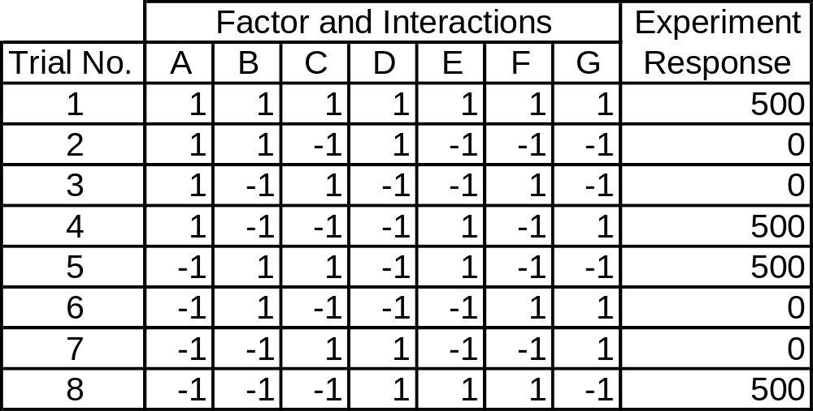
Modified Table 28.4 Example Output from Table 28.3 Design
Notes:
We can estimate 7 main effects in 8 runs by defining:
D = AB
E = BC
F = AC
G = ABC
Suppose we obtained the Experiment Response shown above (this isn’t realistic – it’s greatly simplified to show how the effects are estimated).

Slide 11
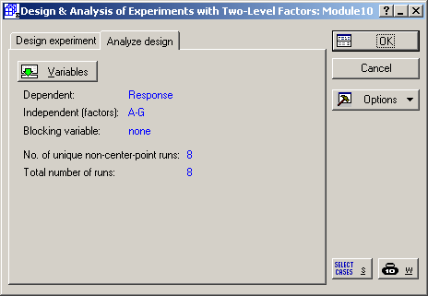
Notes:
Statistics > Industrial Statistics & Six Sigma > Experimental Design (DOE) > 2**(K-p) standard designs > Analyze design
Dependent = Response
Independent (factors) = A, B, C, D, E, F and G
Select “OK”.

Slide 12
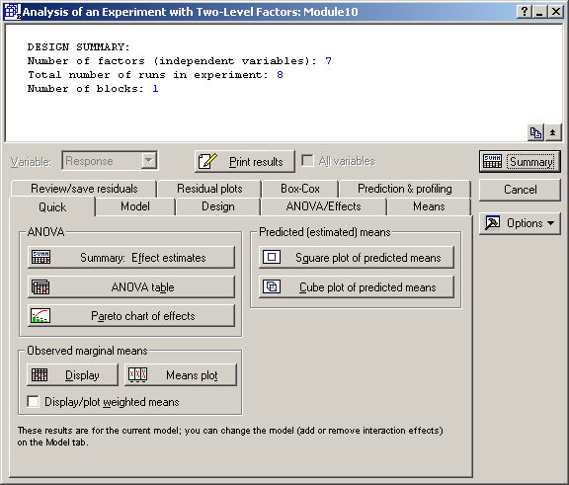
Notes:
Select “Summary: Effect estimates”

Slide 13
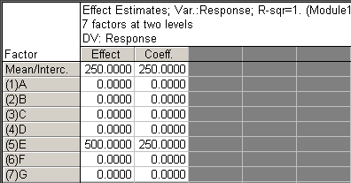
Notes:
Page 560 shows how the main effects for A and E are calculated:
Effect E = 500
Effect A = 0
Page 585 and 586 shows the prediction equation, which is based on the DOE coefficients:
y = 250 + 0*A + 0*B + 0*C + 0*D + 250*E + 0*F + 0*G, or
y = 250 + 250*E

Slide 14
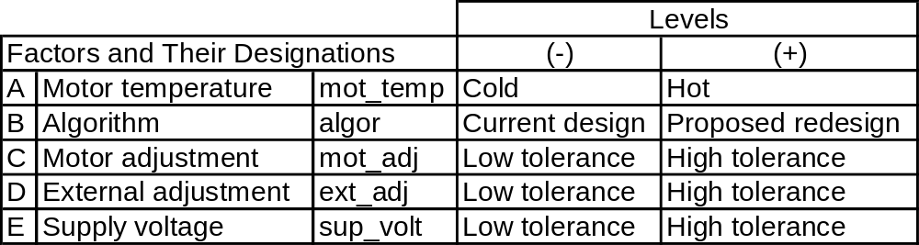
30.5 Example 30.1: A Resolution V DOE
Notes:
Want a resolution V design: can estimate all main effects and two-way interactions separately.
Need to run half of the possible 32 trials, i.e. 16 trials.
Notation: (2⁵)/2 = 2⁵ / 2¹ = 2⁵ * 2⁻¹ = 2⁵⁻¹

Slide 15
Notes:
Statistics > Industrial Statistics & Six Sigma > Experimental Design (DOE) > 2**(K-p) standard designs

Slide 16
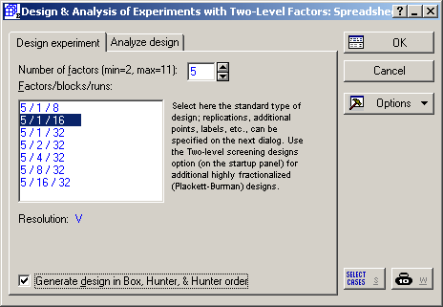
Notes:
Number of factors = 5
Factors/blocks/runs = 5/1/16
Note: Resolution = V
Select “OK”.
You could also uncheck “Generate design in standard Box, Hunter & Hunter order”.

Slide 17
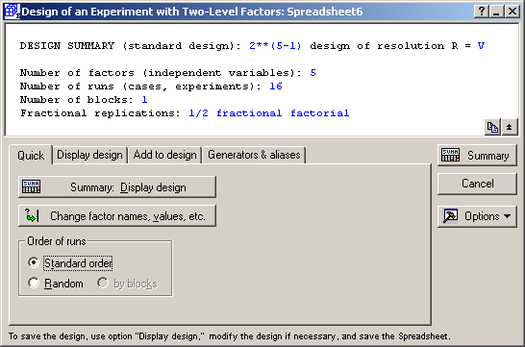
Notes:
Summary data is listed in the top section.
Change the “Order of runs” to “Standard order”. [Use “Random” order when you have finalized the design and are ready to run the experiments.]
The select “Change factor names, values, etc.”.

Slide 18
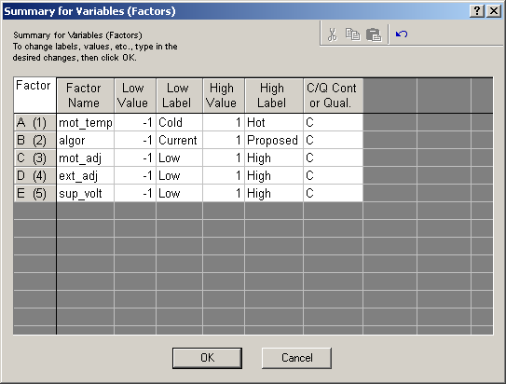
Notes:
Enter the Factor Names, Low Labels and High Labels.
If we knew the values of Low and High, we could enter those too and have a better data collection sheet, but they are not provided in the text.
Clicking OK returns you to the DOE menu. Select “Summary: Display design”.

Slide 19
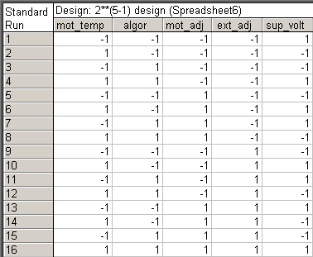
Notes:
Compare to Table 30.3 Test Design with Trial Responses.
The same combinations are listed, but the order of the rows is different. One could sort the rows to get them to match, but that would be superfluous. You could also uncheck “Generate design in standard Box, Hunter & Hunter order” on the menu where you specified the number of factors and runs, but that still doesn’t match Table 30.3 (and who cares anyway).
We need to add the response data – output timing – but it is often easier to enter the data in Excel and transfer it to Statistica, which we will do soon.

Slide 20
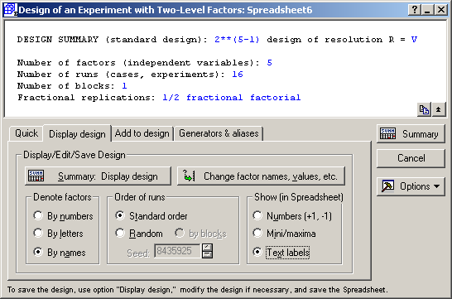
Notes:
Just for educational purposes, let’s use the information we entered for Factor Labels.
Return to the DOE menu, go to the “Display design” tab, and change from “Mini/maxima” to “Text labels” in the “Show (in Spreadsheet)” section.
Then select “Summary: Display design”.

Slide 21
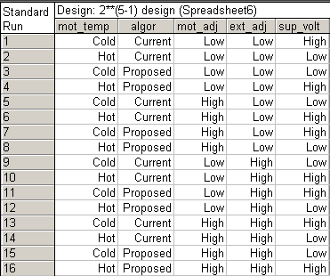
Notes:
After randomizing the run order, this would be a better form of data collection sheet; otherwise, the person conducting the experiment would have to remember what -1 and +1 meant for each variable, and that in prone to induce errors. Even better would be to show the actual values of Cold/Hot and Low/High if we knew them.

Slide 22
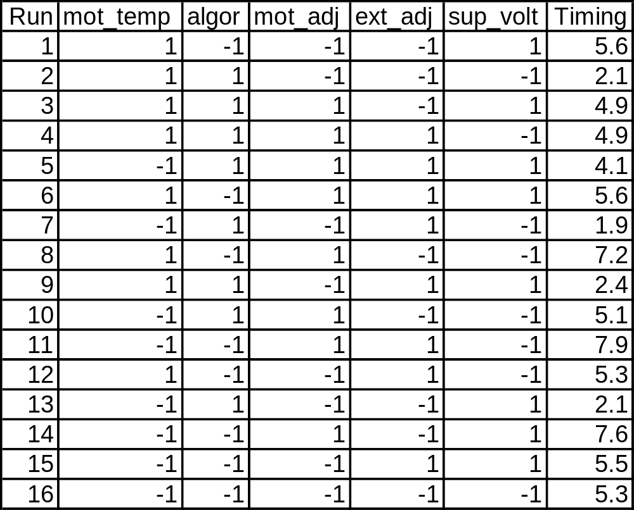
Table 30.3 Test Design with Trial Responses
Notes:
Now we have a matrix of the factors, their settings, and the resulting response: Timing.
After transferring the data to Statistica, we can analyze it using the DOE menus.

Slide 23
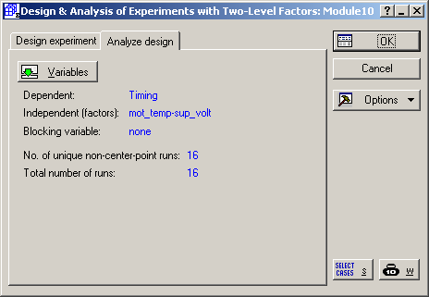
Notes:
Statistics > Industrial Statistics & Six Sigma > Experimental Design (DOE) > 2**(K-p) standard designs > Analyze design
Dependent = Timing
Independent (factors) = mot_temp, algor, mot_adj, ext_adj, and sup_volt
Select “OK”.

Slide 24
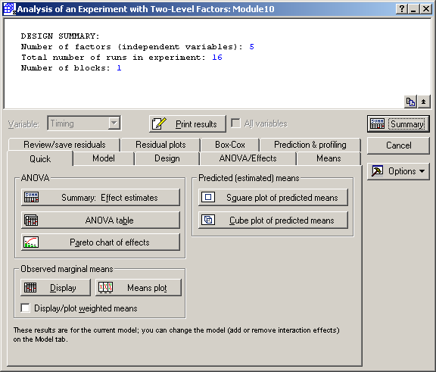
Notes:
Here’s the Quick tab that gives the most common analysis methods, but we’re not ready for that yet.

Slide 25
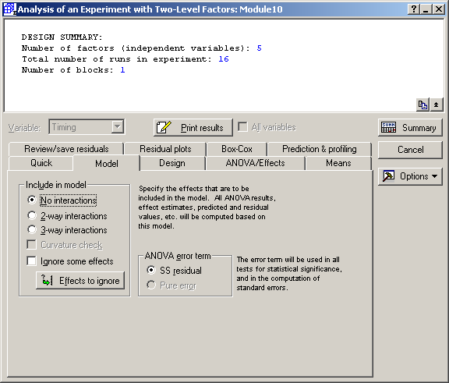
Notes:
Go to the “Model” tab and select “No interactions” in the “Include in model” section.

Slide 26
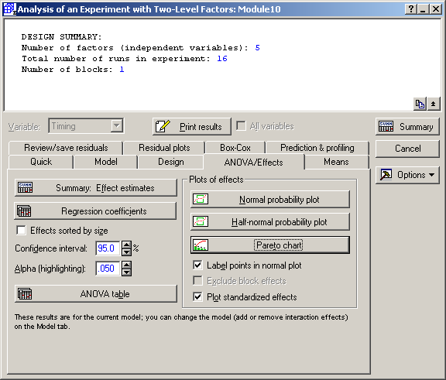
Notes:
Go to the “ANOVA/Effects” tab and select:
Summary: Effect estimates
ANOVA table

Slide 27
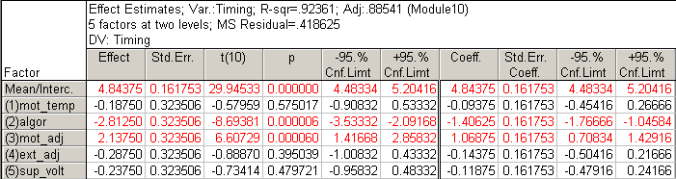
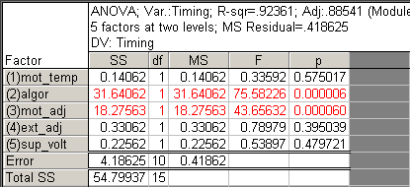
Notes:
The table on top results from the “Summary: Effect estimates” button.
The table on bottom results from the “ANOVA table” button.
Together they provide the information contain in the “Fractional Factorial Fit” output on page 590.
We can quickly see that only algor and mot_adj are statistically significant factors.

Slide 28

Notes:
No go back to the “Model” tab and select “2-way interactions” in the “Include in model” section.

Slide 29
Notes:
Return to the “ANOVA/Effects” tab and select:
Normal probability plot
Pareto chart

Slide 30
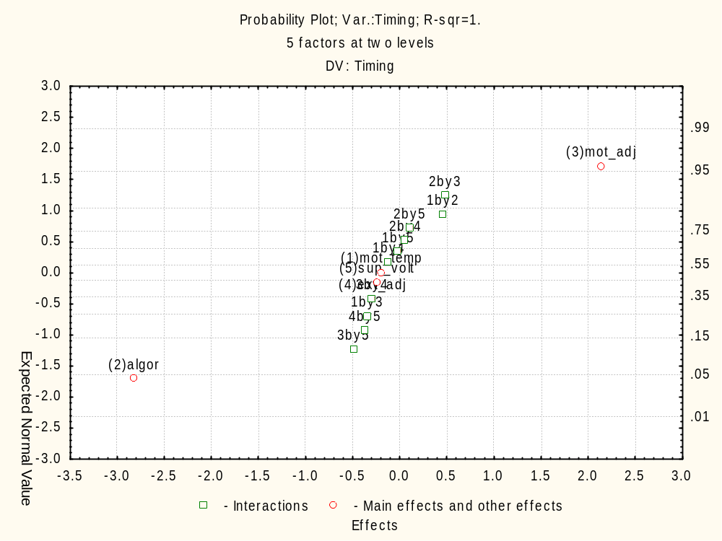
Notes:
Compare to FIGURE 30.1 Normal probability plot of the effects.
This confirms that there are no significant two-way interactions to worry about.

Slide 31
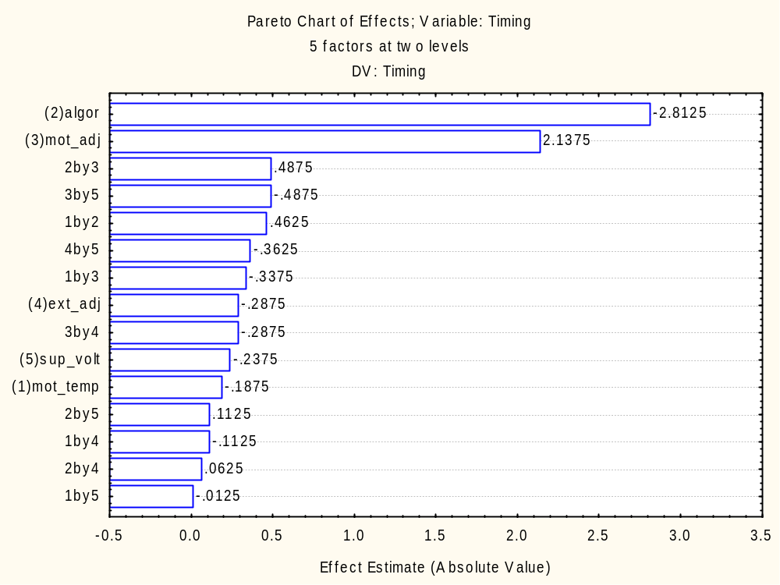
Notes:
Compare to FIGURE 30.2 Pareto chart of the effects.
This also confirms that there are no significant two-way interactions to worry about.
Note: Go to plot options by double clicking outside the plot area and select Skip values = Off on the “Axis: Scale Values” tab (this is a rather annoying “feature” of Statistica).

Slide 32
Notes:
Since there are only two significant effects - algor and mot_adj – we should eliminate the non-significant terms (i.e. “reduce” our model) and check our assumptions by examining the residuals.
Go to the “Model” tab and select “No interactions” in the “Include in model” section, and then select “Effects to ignore”.

Slide 33
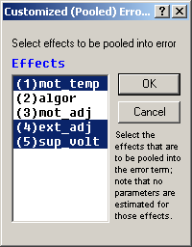
Notes:
Eliminate mot_temp, ext_adj and sup_volt from the model by holding down the Ctrl button and clicking on these three terms. Then click on OK.
Go to the “ANOVA/Effects” tab and select:
Summary: Effect estimates
ANOVA table

Slide 34
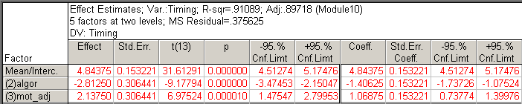
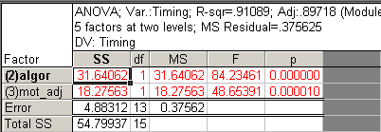
Notes:
Compare these results to those listed in the “Fractional Factorial Fit” output on page 592. The ANOVA table is more complicated on page 592, because it checks for “Lack of Fit”. This is an advanced topic that was not discussed in the text, so we will skip it too.
So far, the modeling equation is:
Timing = 4.844 – 1.406(algor) + 1.069(mot_adj)

Slide 35
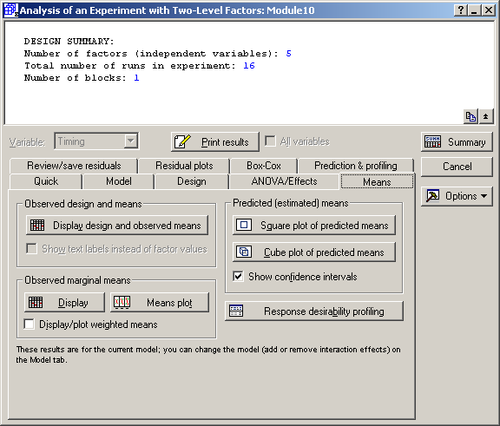
Notes:
Go to the “Means” tab and select “Means plot” in the “Observed marginal means” section.

Slide 36
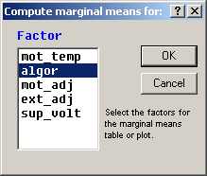
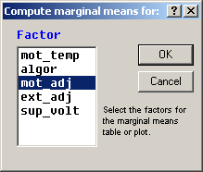
Notes:
We will to this twice. The first time select “algor”, and the second time select “mot_adj”.

Slide 37
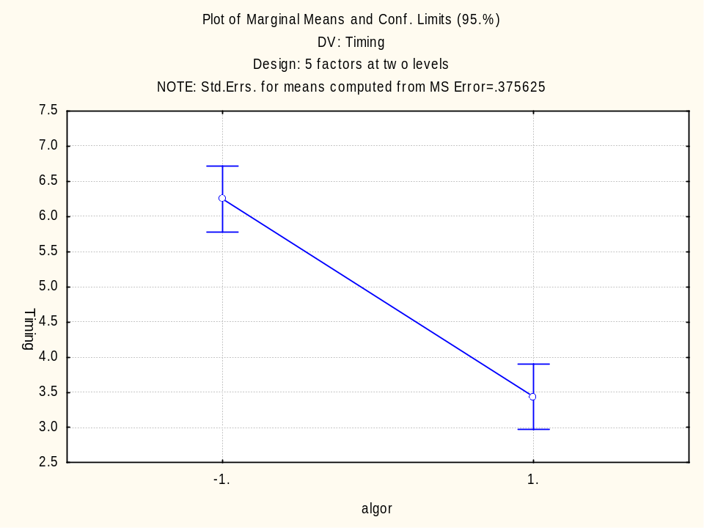
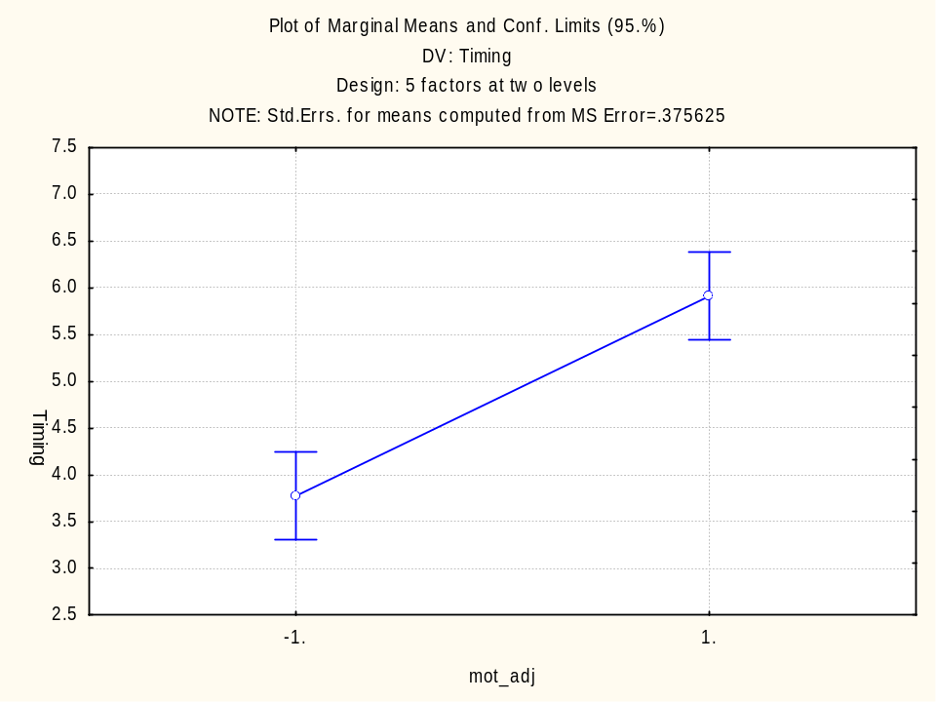
Notes:
Compare to FIGURE 30.3 Main effect plots of significant factors.
If we want to minimize Timing, the we should use algor = +1 (Proposed redesign) and mot_adj = -1 (Low tolerance).
Note: the scaling for “mot_adj” was different, so it was manually change to match “algor” by double clicking outside the plot area to get the plot options and selecting Axis = Y Left and Maximum = 7.5 on the “Axis: Scaling” tab (again, this is a rather annoying “feature” of Statistica).

Slide 38
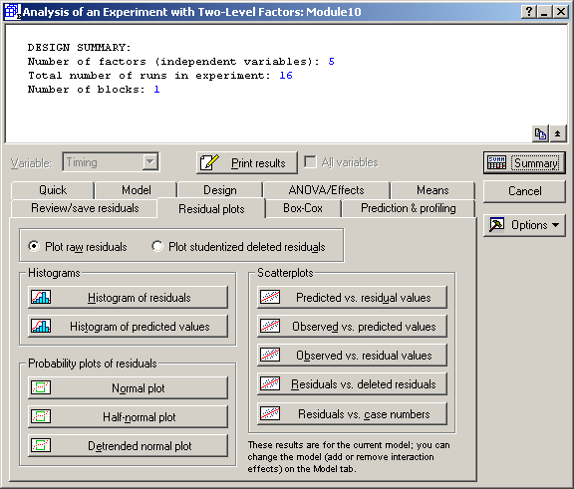
Notes:
Now let’s examine the residuals.
Go to the “Residual plots” tab and select:
“Predicted vs. residuals” values in the “Scatterplots” section
“Normal plot” in the “Probabiity plots of residuals” section

Slide 39
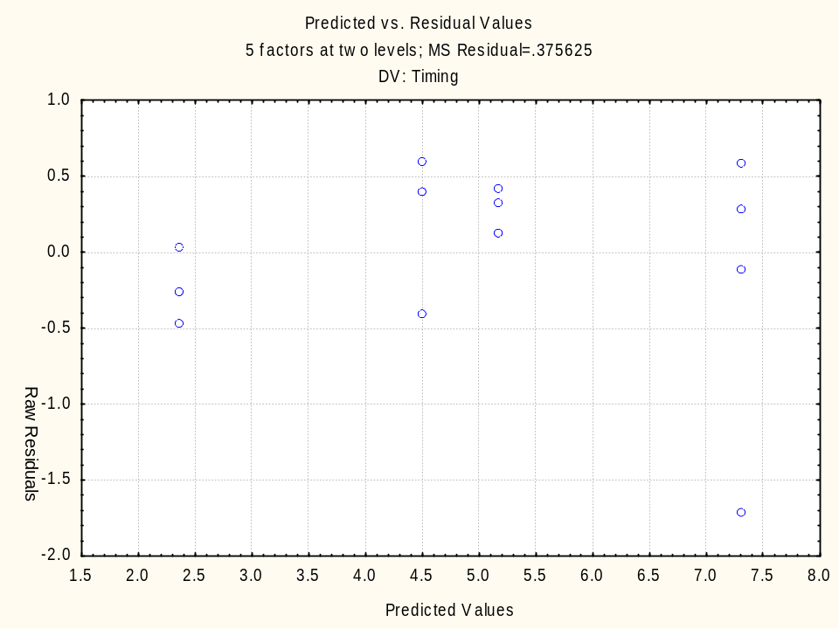
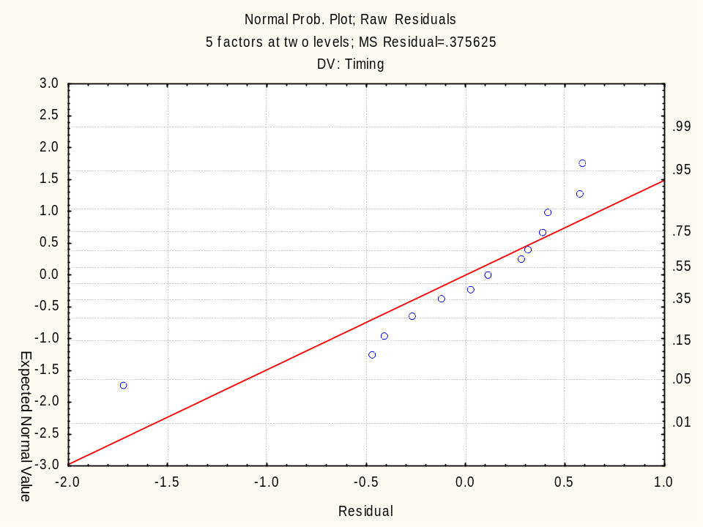
Notes:
Compare the plot on the left to FIGURE 30.4 Residuals versus fitted values and the plot on the right to FIGURE 30.5 Normal probability plot of residuals.
Clearly Observation 6 is an outlier, and it is biasing the estimation of the coefficients. The author recommends removing this observation and recalculating the prediction model. To do this in Statistica, we can simply exclude Case 6 from the analysis.

Slide 40
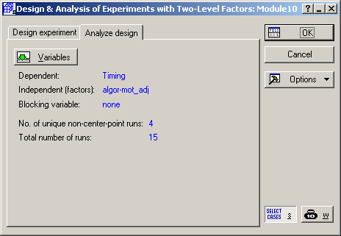
Notes:
Cancel out of the analysis to return to the “Analyze design” tab and select the variables:
Dependent = Timing
Independent (factors) = algor and mot_adj
Now select the “SELECT CASES” button.

Slide 41
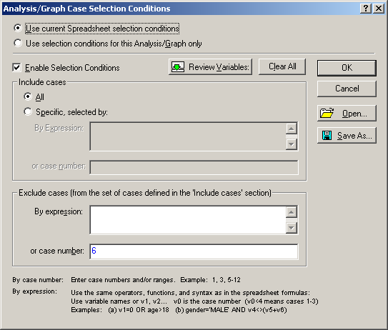
Notes:
Check “Enable Selection Conditions” and enter “6” in the “or case number” field in the “Exclude cases” section.

Slide 42
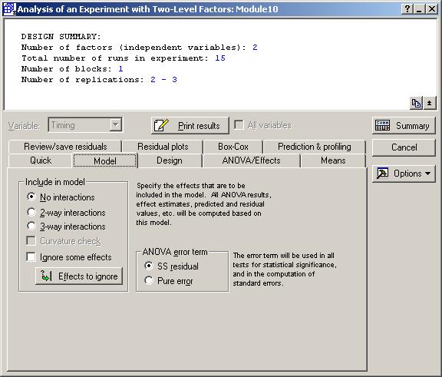
Notes:
Go to the “Model” tab and select “No interactions” in the “Include in model” section; otherwise, we will get the 2-way interaction term with algor and mot_adj included in the model.

Slide 43
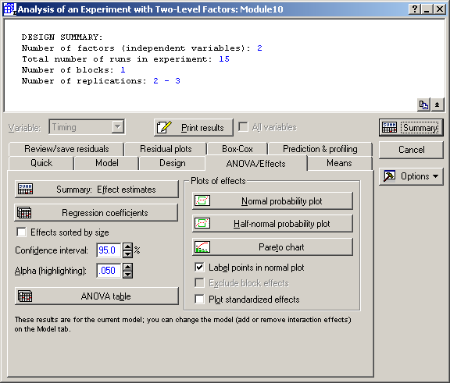
Notes:
Go to the “ANOVA/Effects” tab and select:
Summary: Effect estimates
ANOVA table

Slide 44
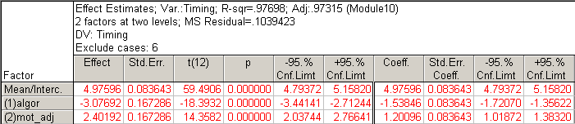
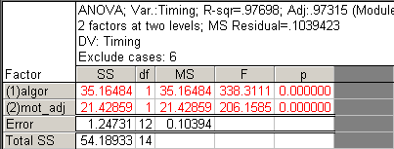
Notes:
Compare these results to those listed in the “Fractional Factorial Fit” output on page 595. Again, the ANOVA table is more complicated on page 592, because it checks for “Lack of Fit,” and, again, we will skip it.
Now the modeling equation is:
Timing = 4.976 – 1.538(algor) + 1.120(mot_adj)

Slide 45
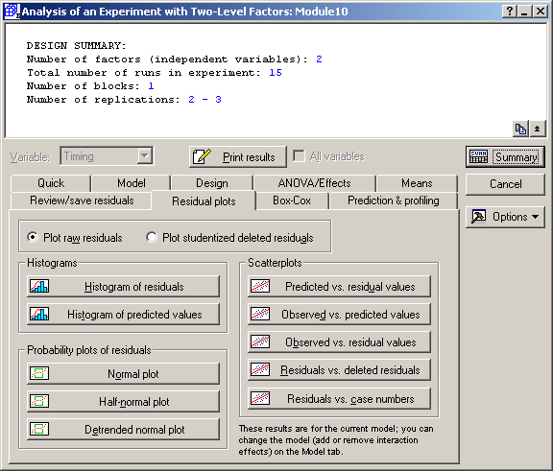
Notes:
Now let’s examine the residuals.
Go to the “Residual plots” tab and select:
“Predicted vs. residuals” values in the “Scatterplots” section
“Normal plot” in the “Probabiity plots of residuals” section

Slide 46
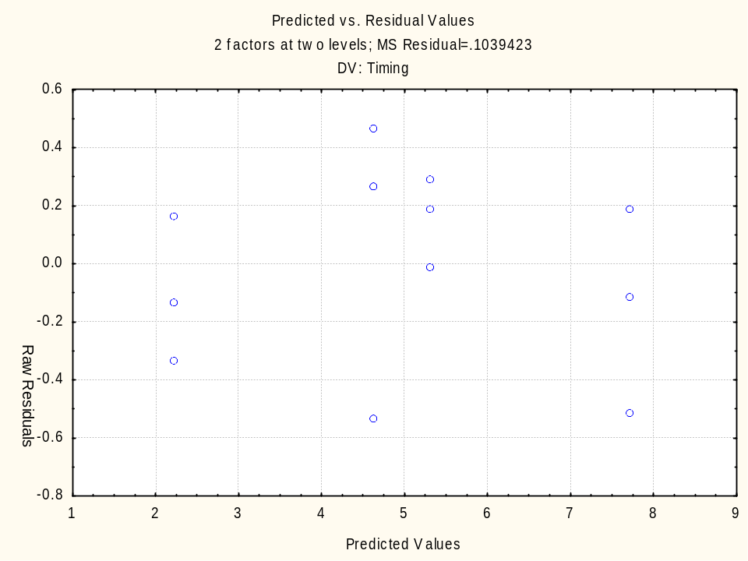

Notes:
Compare the plot on the left to FIGURE 30.6 Residuals versus fitted values (second analysis) and the plot on the right to FIGURE 30.7 Normal probability plot of residuals (second analysis).
Everything looks OK now, so the prediction model:
Timing = 4.976 – 1.538(algor) + 1.120(mot_adj)
should be OK to use.

Slide 47

Notes:
Just for fun, let’s pretend that there is a two-way interaction between algor and mot_adj and make an interaction plot so you can see what it would look like.
First we need to be able to include the 2-way interaction term, so once again, go to the “Model” tab and select “2-way interactions” in the “Include in model” section.

Slide 48

Notes:
Go to the “Means” tab and select “Means plot” in the “Observed marginal means” section.

Slide 49


Notes:
Select both algor and mot_adj in the “Compute marginal means for” box, and click “OK”.
The “Arangement of factors” box will appear. Select algor for the “x-axis, upper” and mot_adj for the “Line pattern”. Then click “OK”. You can try switching them if you like. Sometimes it’s better one way than another, and sometimes it doesn’t make a bit of difference, but you don’t know until you try both.

Slide 50

Notes:
Here’s an interaction plot, i.e. a plot of one of the Xs – algor in this case – versus the response – Timing – with two lines, one for the other X (mot_adj) at its low setting and one for the other X (mot_adj) at its high setting.
We are looking for parallelism. If the lines are approximately parallel, that is a good indication that there is no interaction, which is the case here. If the line were not parallel, that is a good indication that there is an interaction.
Also, this serves as a good communication tool to explain the nature of the interaction to others, because this concept can often be confusing. In this case, we can easily see that the fastest times are achieved when algor = 1 and mot_adj = -1.

